Slide 1

Image Scraping and classification Project
By Khushboo Khatri

Slide 2
Image Scraping and Classification
Data Collection using Web Scraping
01
Image Classification Model using Deep Learning
02

Slide 3
Agenda
1. Introduction
2. Data Collection
3. Model Building
4. How Image Classification Works in Deep Learning
5. Pre Processing
6. Visualization of data
7. Model Check point
8. Evaluation
9. Conclusions

Slide 4
Introduction
Problem Statement: Images are one of the major sources of data in the field of data science and AI. This field is making appropriate use of information that can be gathered through images by examining its features and details.
The idea behind this project is to build a deep learning-based Image Classification model on images that will be scraped from e-commerce portal. This is done to make the model more and more robust.
This project is divided into two parts:
For this project we divide it into two phase:
1. Data collection
2. Model Building

Slide 5
Data Collection
In this section, you need to scrape images from e-commerce portal, Amazon.com. The clothing categories used for scraping will be:
Sarees (women)
Trousers (men)
Jeans (men)
You need to scrape images of these 3 categories and build your data from it. That data will be provided as an input to your deep learning problem. You need to scrape minimum 200 images of each category. There is no maximum limit to the data collection. You are free to apply image augmentation techniques to increase the size of your data but make sure the quality of data is not compromised.
Remember, in case of deep learning models, the data needs to be big for building a good performing model. More the data, better the results.

Slide 6
Model Building
After the data collection and preparation is done, you need to build an image classification model that will classify between these 3 categories (Sarees for women, Jeans for men, Trousers for men).
For Model Building, here we are using Deep Learning Algorithms. Image classification with deep learning most often involves convolutional neural networks, or CNNs. In CNNs, the nodes in the hidden layers don't always share their output with every node in the next layer (known as convolutional layers). Deep learning allows machines to identify and extract features from images.
Image classification is a supervised learning problem: define a set of target classes (objects to identify in images), and train a model to recognize them using labeled example photos. Early computer vision models relied on raw pixel data as the input to the model.
Here we first load the data, then resize it using resize()
After that we need to flatten the data to make it suitable for image processing, then will use it in model building.

Slide 7
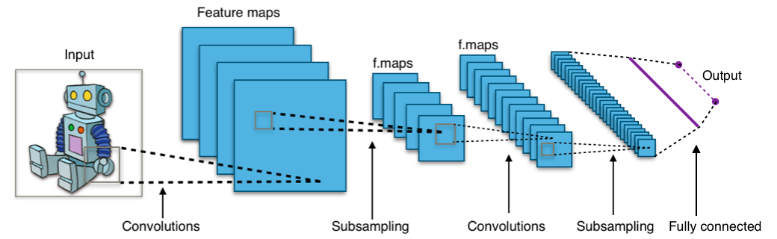
How Image Classifications works in Deep Learning

Slide 8
Pre Processing
Preprocessing refers to all the transformations on the raw data before it is fed to the machine learning or deep learning algorithm. For instance, training a convolutional neural network on raw images will probably lead to bad classification performances
For pre processing image data, we need to first resize the data so that, we have uniformity. As we collect data from real time, resizing is important
Second part of pre processing image involves Flatten the data, it helps to bring it to single linear vector.
In Deep learning, we also Dense Flat_data, Dense Layer is simple layer of neurons in which each neuron receives input from all the neurons of previous layer, thus called as dense. Dense Layer is used to classify image based on output from convolutional layers. Working of single neuron. A layer contains multiple number of such neurons.
Image classification with deep learning most often involves convolutional neural networks, or CNNs. In CNNs, the nodes in the hidden layers don't always share their output with every node in the next layer (known as convolutional layers). Deep learning allows machines to identify and extract features from images.

Slide 9
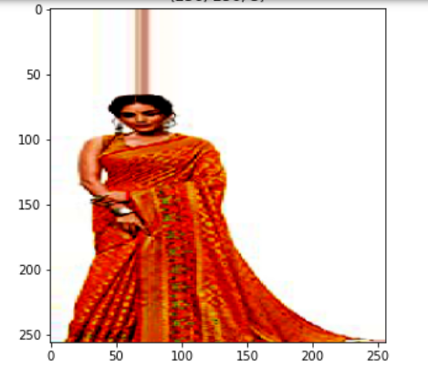
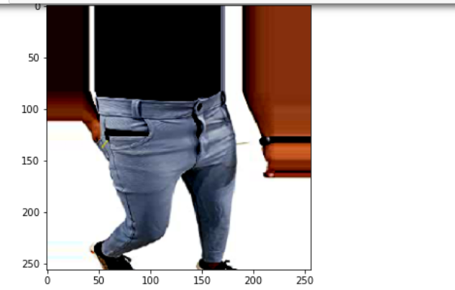
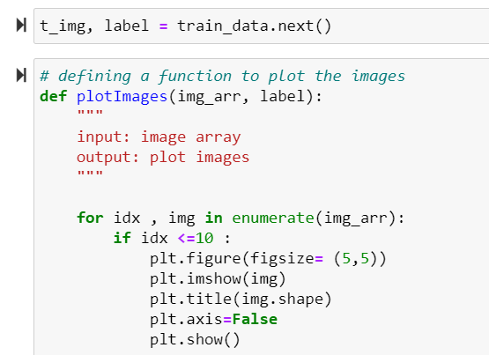
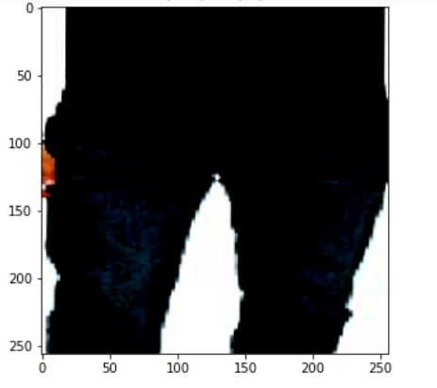
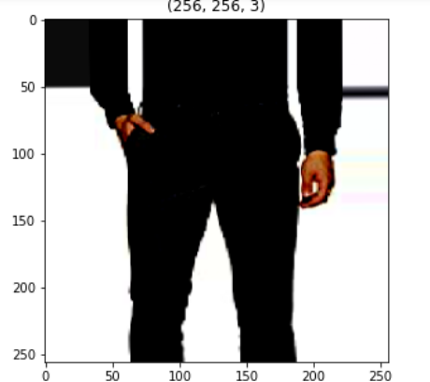
Visualization Of data:

Slide 10
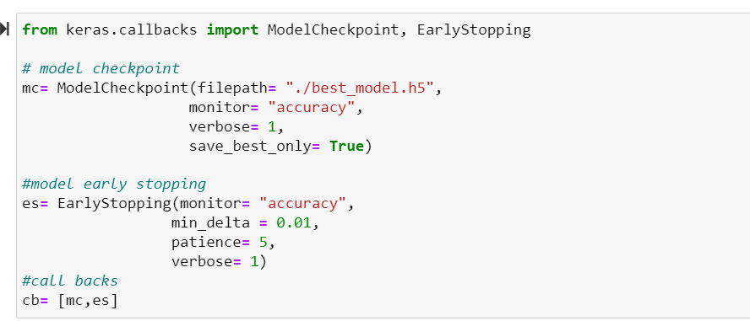
Model Check Point
A good application of checkpointing is to serialize your network to disk each time there is an improvement during training. We define an “improvement” to be either a decrease in loss or an increase in accuracy — we’ll set this parameter inside the actual Keras callback.
In this we define the file path, we are checking on the basis of accuracy, i.e. our primary metrics. Also we are setting save_best_only as True because we want to save the best model.
We use early stopping here, as we don’t want to go in long loop to get the results, machine we stop calculating further if it won’t see any improvements I the result going forward.

Slide 11
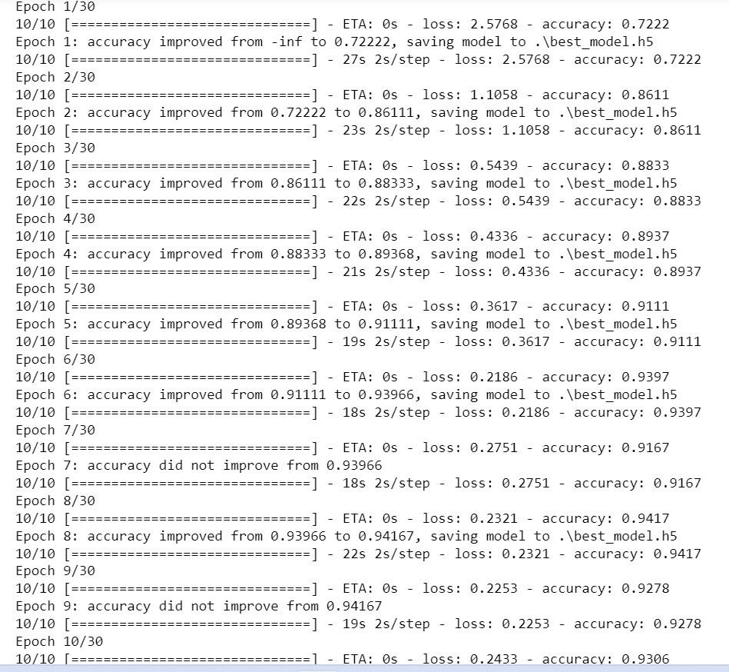
We are using fit_generator here firstly as we are working on real time data and also Keras use it for data augmentation, means ultimately our model is performing hyper parameter tuning in terms of machine learning.

Slide 12
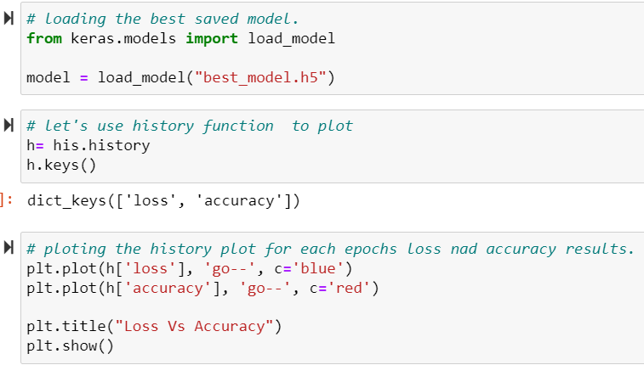
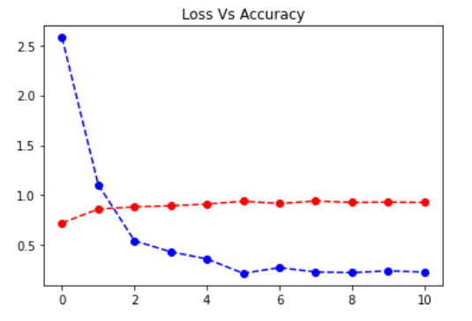
Evaluation
We start with loading the best saved model.
From here we can observe that the loss value decreases with each successive epochs, and we also encounter slight increase in accuracy . The highest accuracy what we get is .946 while the loss is 0.2

Slide 13
Conclusions
Our entire dataset is divided into three categories, or we can call them classes of label. (Sarees for women, Trousers for men , Jeans for men)
With the help deep learning keras the model we build, gives us an accuracy of 94.6%
It is a CNN model, which also helps to retain maximum data and prevents data loss. In our case the loss is about .2 which is decent.
Image Classification in Deep learning happens at various layers. Convolutional Neural Networks come under the subdomain of Machine Learning which is Deep Learning.

Slide 14
Thank you

